Slide 1
Gurudeva.com-new

Slide 2
IF YOU ARE ALIVE
PLEASE VOTE
Gurudeva.com_new

Slide 3
CONSTITUTION GAVE US
RIGHT TO FRANCHISE.
DON’T
FORGET
TO VOTE
YOUR FUTURE IS IN YOUR HANDS
Gurudeva.com_new

Slide 4
Gurudeva.com_new

Slide 5
AND
SAVE
DEMOCRACY
Gurudeva.com_new

Slide 6
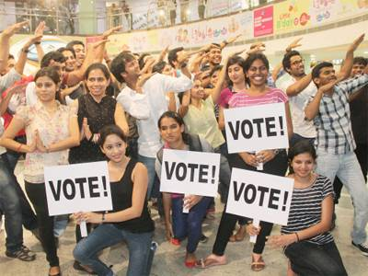

Slide 7
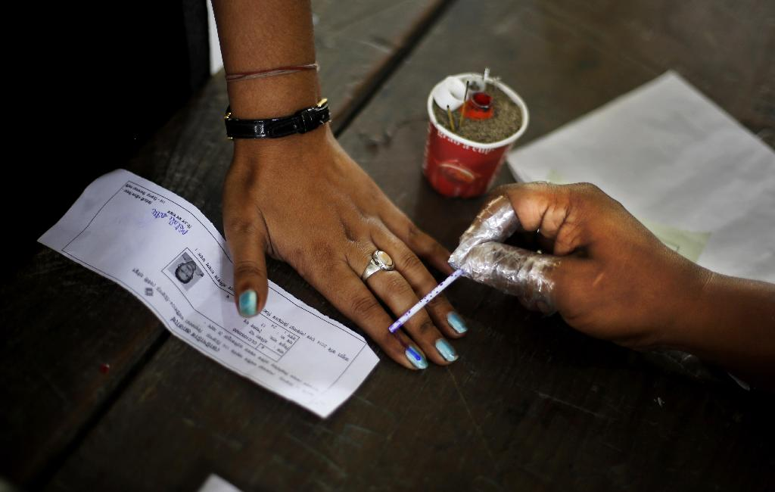
Vote is our right

Slide 8
