Slide 1
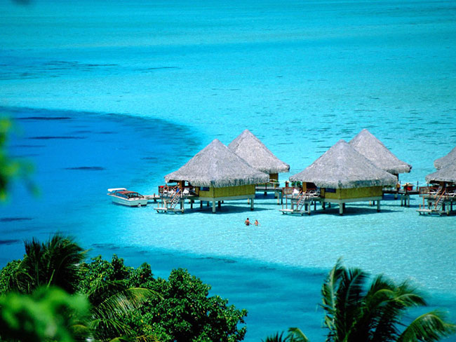
THE COASTAL PLAINS

Slide 2
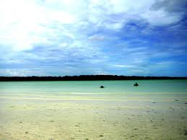
Coastal Plains
Coastal plains are a geologic feature found around the world and on both the eastern and western coasts of India.
Coastal plains are characterized by an area of flat low lying land that is situated adjacent to a water body often a sea or ocean.
The coastal plains of India are relatively expansive regions which contribute significantly to the geography of the region.
Coastal plains have limited vegetation; however grasses and trees are not uncommon.

Slide 3
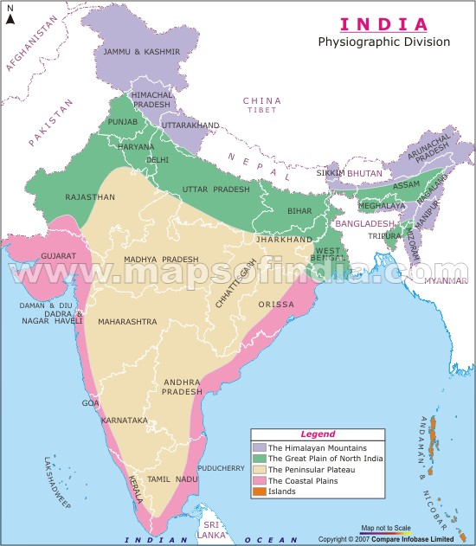

Slide 4
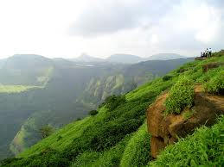
Eastern Coastal Plains
The eastern coastal plains are located on a wide stretch of land between the Eastern Ghats of India and the Bay of Bengal. This stretch of land stretches to 120 km in width at parts.
These pains extend from Tamil Nadu in the south to West Bengal in the north.
The region of the eastern coastal plains is an expansive area and is divided into six regions.
The six regions of the eastern coastal plains of India are-
the Mahanadi Delta
the Southern Andhra Pradesh Plain
the Krishna Godavari deltas
the Kanyakumari Coast,
the Coromandel
the Sandy Coastal regions.

Slide 5
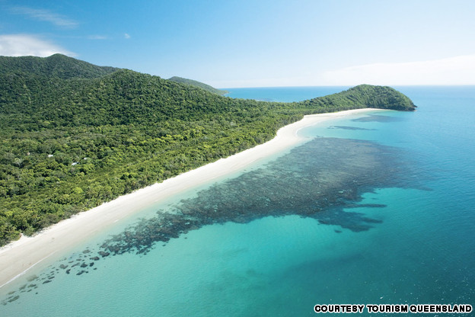
CLIMATE (Eastern Coastal Plains)
The eastern coastal plains are characterized by a temperature that exceeds 30 degrees Celsius and also experiences high levels of humidity.
The rainfall of the region is also abundant in the region with rainfall amounts in excess of 1000mm annually with the amount usually approaching 3000mm.
The region of the eastern coastal plains is subject to both northeast and southwest monsoon rains when these storms are in season.

Slide 6
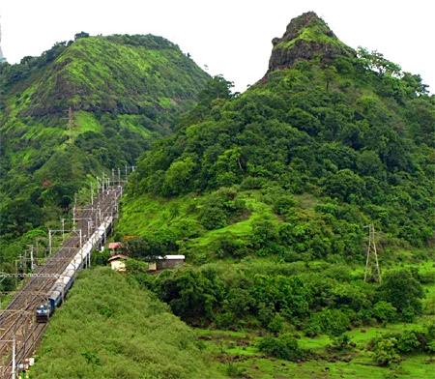
Western Coastal Plains
The western coastal plains of India are located in the west of India between the Western Ghats and the Arabian Sea on a narrow strip of land.
They extend from Gujarat in the north down 50 km to the south in Kerala
The western coastal plains are smaller than their eastern counterpart and the region is divided into three parts. The western coastal plains are divided into the regions of-
Konkan
Kanara
The Malabar Coast.
They are characterized by numerous backwaters and rivers that flow into the region. These rivers that flow into the region lead to the forming of estuaries that are found in the western coastal plains of India.
The maximum storm activity on the western coastal plains occurs in the month of March

Slide 7
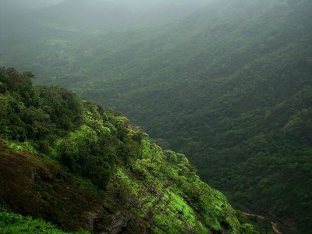
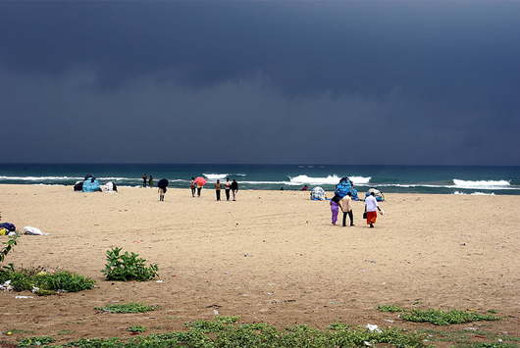
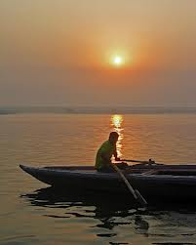
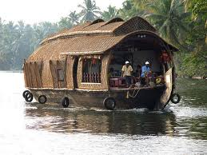
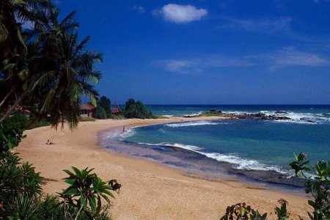
COSATAL PLAINS

Slide 8
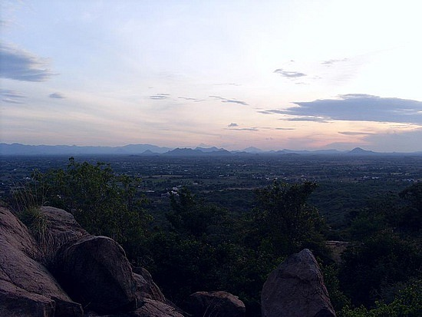
THANK YOU….

