Slide 1
Physiographic divisions of
Presented By
N.SRINIVASARAO

Slide 2
INDIA
India is bounded to the southwest by the Arabian Sea, to the southeast by the Bay of Bengal and the Indian Ocean to the south. Kanyakumari constitutes the southern tip of the Indian peninsula, which narrows before ending in the Indian Ocean. The southernmost part of India is Indira Point in the Andaman And Nicobar Islands. The Maldives, Sri Lanka and Indonesia are island nations to the south of India with Sri Lanka separated from India by a narrow channel of sea formed by Palk Strait and the Gulf of Mannar. The territorial waters of India extend into the sea to a distance of 12nautical miles (13.8 mi; 22.2 km) measured from the appropriate baseline.

Slide 3
Geological Development
India is entirely contained on the Indian plate, a major Tectonic Plate that was formed when it split off from the ancient continent Gondwana land. About 90 million years ago, during the late Cretaceous period, the Indian Plate began moving north at about 15 cm/year (6 in/yr). About 50 to 55 million years ago, in the Eocene Epoch of the Cenozoic Era, the plate collided with Asia after covering a distance of 2,000 to 3,000 km (1,243 to 1,864 mi), having moved faster than any other known plate. In 2007, German geologists determined that the Indian Plate was able to move so quickly because it is only half as thick as the other plates which formerly constituted Gondwanaland. The collision with the Eurasian Plate along the modern border between India and Nepal formed the orogenic belt that created the Tibetan Plateau and the Himalayas. As of 2009, the Indian Plate is moving northeast at 5 cm/yr (2 in/yr), while the Eurasian Plate is moving north at only 2 cm/yr (0.8 in/yr). India is thus referred to as the "fastest continent“. This is causing the Eurasian Plate to deform, and the Indian Plate to compress at a rate of 4 mm/yr (0.15 in/yr).

Slide 4
Physiographic Divisions
India is divided into seven physiographic regions. They are:
The northern mountains including the Himalayas, which includes the Kuen Lun and the Karakoram ranges and the northeast mountain ranges.
Indo-Gangetic Plain
Indian Desert
Central Highlands and Deccan Plateau
East Coast
West Coast
Islands

Slide 5
Mountains
A great arc of mountains, consisting of the Himalayas, Hindu Kush, and Patkai ranges define the northern Indian subcontinent. These were formed by the ongoing of the Indian Plate with the Eurasian Plate that started around 50 million years ago. The mountains in these ranges include some of the world's tallest mountains which act as a natural barrier to cold polar winds. They also facilitate the monsoon winds which in turn influence the climate in India. Rivers originating in these mountains flow through the fertile Indo–Gangetic plains. These mountains are recognized by biogeography's as the boundary between two of the Earth's great ecozones: the temperate Palearctic that covers most of Eurasia and the tropical and subtropical Indomalaya ecozone which includes the Indian subcontinent, Southeast Asia and Indonesia.

Slide 6
India has eight major mountain ranges having peaks of over 1,000 m (3,281 ft):
The Himalayan range is considered as the world's highest mountain range. They form India's northeastern border, separating it from northeastern Asia. They are one of the world's youngest mountain ranges and extend almost uninterrupted for 2,500 km (1,553 mi), covering an area of 500,000 km² (193,051 sq mi). The Himalayas extend from Jammu and Kashmir in the west to Arunachal Pradesh in the east. These states along with Himachal Pradesh, Uttarakhand, and Sikkim lie mostly in the Himalayan region. Numerous Himalayan peaks rise over 7,000 m (22,966 ft) and the snow line ranges between 6,000 m (19,685 ft) in Sikkim to around 3,000 m (9,843 ft) in Kashmir. Kanchenjunga—on the Sikkim–Nepal border—is the highest point in the area administered by India. Most peaks in the Himalayas remain snowbound throughout the year. The Himalayas act as a barrier to the frigid katabatic winds flowing down from Central Asia. Thus, North India is kept warm or only mildly cooled during winter; in summer, the same phenomenon makes India relatively hot.
Mt. Kanchenjunga in Sikkim

Slide 7
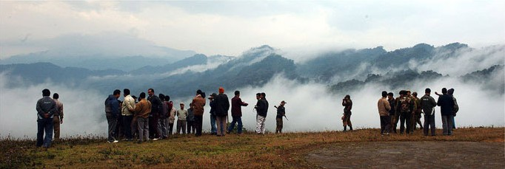
The Karakoram is situated in the disputed state of Jammu and Kashmir. It has more than sixty peaks above 7,000 m (22,966 ft), including K2, the second highest peak in the world 8,611 m (28,251 ft). K2 is just 237 m (778 ft) smaller than the 8,848 m (29,029 ft) Mount Everest. The range is about 500 km (311 mi) in length and the most heavily glaciatedpart of the world outside of the polar regions.
The Patkai, or Purvanchal, are situated near India's eastern border with Myanmar. They were created by the same tectonic processes which led to the formation of the Himalayas. The physical features of the Patkai mountains are conical peaks, steep slopes and deep valleys. The Patkai ranges are not as rugged or tall as the Himalayas. There are three hill ranges that come under the Patkai: the Patkai–Bum, the Garo-Khasi-Jaintia and the Lushai Hills. The Garo–Khasi range lies in Meghalaya. Mawsynram, a village near Cherrapunji lying on the windward side of these hills, has the distinction of being the wettest place in the world, receiving the highest annual rainfall.

Slide 8
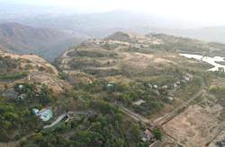
The Vindhya range runs across most of central India, extending 1,050 km (652 mi). The average elevation of these hills is 3,000 m (9,843 ft).They are believed to have been formed by the wastes created by the weathering of the ancient Aravali mountains. Geographically, it separates northern India from southern India. The western end of the range lies in eastern Gujarat, near its border with Madhya Pradesh, and runs east and north, almost meeting the Ganges at Mirzapur.
The Satpura Range begins in eastern Gujarat near the Arabian Sea coast and runs east across Maharashtra, Madhya Pradesh and Chhattisgarh. It extends 900 km (559 mi) with many peaks rising above 1,000 m (3,281 ft). It is triangular in shape, with its apex at Ratnapuri and the two sides being parallel to the tapti and Narmada rivers. It runs parallel to vindhya range, which lies to north and these two east-west ranges divide the Indo–Gangetic plain from the Deccan Plateau located north of River Narmada.

Slide 9
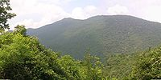
The Aravali Range is the oldest mountain range in India, running across Rajasthan from northeast to southwest direction, extending approximately 800 km (497 mi). The northern end of the range continues as isolated hills and rocky ridges into Haryana, ending near Delhi. The highest peak in this range is Guru Shikhar at Mount Abu, rising to 1,722 m (5,650 ft), lying near the border with Gujarat. The Aravali Range is the eroded stub of an ancient fold mountain system. The range rose in a Precambrian event called the Aravali–Delhi origin.
The Eastern Ghats are a discontinuous range of mountains, which have been eroded and vivisected by the four major rivers of southern India, theGodavari, Mahanadi, Krishna, and Kaveri. These mountains extend from West Bengal to Orissa, Andhra Pradesh and Tamil Nadu, along the coast and parallel to the Bay of Bengal. Though not as tall as the Western Ghats, some of its peaks are over 1,000 m (3,281 ft) in height. The Nilgiri hills in Tamil Nadu lies at the junction of the Eastern and Western Ghats.

Slide 10
The Western Ghats or Sahyadri mountains run along the western edge of India's Deccan Plateau and separate it from a narrow coastal plain along the Arabian Sea. The range runs approximately 1,600 km (994 mi) from south of the Tapti River near the Gujarat–Maharashtra border and across Maharashtra, Goa, Karnataka, Kerala and Tamil Nadu to the southern tip of the Deccan peninsula. The average elevation is around 1,000 m (3,281 ft). Anai Mudi in the Anaimala Hills 2,695 m (8,842 ft) in Kerala is the highest peak in the Western Ghats.

Slide 11
Seasonal Winds
Seasonal winds are called monsoons. Monsoons provide rainy summers and dry winters. Monsoon is traditionally defined as a seasonal reversing wind accompanied by corresponding changes in precipitation, but is now used to describe seasonal changes in atmospheric circulation and precipitation associated with the asymmetric heating of land and sea. Usually, the term monsoon is used to refer to the rainy phase of a seasonally-changing pattern, although technically there is also a dry phase.

Slide 12
Indo-Gangetic Plain
The Indo-Gangetic plains, also known as the Great Plains are large floodplains of the Indus and the Ganges-Brahmaputra river systems. They run parallel to the Himalaya mountains, from Jammu and Kashmir in the west to Assam in the east and draining most of northern and eastern India. The plains encompass an area of 700,000 square kilometers (270,272 sq mi). The major rivers in this region are the Ganges and the Indus along with their tributaries–Beas,Yamuna, Gomti, Ravi Chambal, Sutlej and Chenab.

Slide 13
The great plains are sometimes classified into four divisions:
The Bhabar belt — is adjacent to the foothills of the Himalayas and consists of boulders and pebbles which have been carried down by the river streams. As the porosity of this belt is very high, the streams flow underground. The bhabar is generally narrow with its width varying between 7 to 15 km.
The Terai belt — lies next to the Bhabar region and is composed of newer alluvium. The underground streams reappear in this region. The region is excessively moist and thickly forested. It also receives heavy rainfall throughout the year and is populated with a variety of wildlife.
The Bangar belt — consists of older alluvium and forms the alluvial terrace of the flood plains. In the Gangetic plains, it has a low upland covered by laterite deposits.
The Khadar belt — lies in lowland areas after the Bangar belt. It is made up of fresh newer alluvium which is deposited by the rivers flowing down the plain.

Slide 14
Indian Desert
The Indian Desert (Thar Desert) lies towards the western margins of the Aravali Hills. It is an undulating sandy plain covered with sand dunes. This region receives very low rainfall below 150 mm per year. The Thar Desert (also known as the Great Indian Desert) is the world's seventh largest desert; it forms a significant portion of western India and covers an area of 238,700 km² (92,200 mile²). The desert continues into Pakistan as the Cholistan Desert. Most of the Thar Desert is situated in Rajasthan, covering 61% of its geographic area.

Slide 15
About 10 percent of this ecoregion comprises sand dunes, and the remaining 90 percent consist of craggy rock forms, compacted salt-lake bottoms, and interdunal and fixed dune areas. Annual temperatures can range from 0°C in the winter to over 50°C during the summer. Most of the rainfall received in this region is associated with the short July–September southwest monsoon that brings around 100–500 mm of precipitation. Water is scarce and occurs at great depths, ranging from 30 to 120 m below the ground level. Rainfall is precarious and erratic, ranging from below 120 mm (4.72 inches) in the extreme west to 375 mm (14.75 inches) eastward. The soils of the arid region are generally sandy to sandy-loam in texture. The consistency and depth vary as per the topographical features. The low-lying loams are heavier and may have a hard pan of clay, calcium carbonate or gypsum.

Slide 16
Highlands The central highlands comprises of three main plateaus- The Malwa Plateau in the west, the Deccan Plateau in the south (covering most of the Indian peninsula) and the Chota Nagpur Plateau in the east.

Slide 17
The Malwa Plateau
The Malwa Plateau is spread across Rajasthan, Madhya Pradesh and Gujarat.The average elevation of the Malwa plateau is 500 metres, and the landscape generally slopes towards the north. Most of the region is drained by the Chambal River and its tributaries; the western part is drained by the upper reaches of the Mahi River. Ujjain was the political, economic, and cultural capital of the region in ancient times, and Indore is presently the largest city and commercial centre. Overall, agriculture is the main occupation of the people of Malwa. The region has been one of the important producers of opium in the world. Cotton and soybeans are other important cash crops, and textiles are a major industry.

Slide 18
The Deccan Plateau
The Deccan Plateau is a large triangular plateau, bounded by the Vindhyas to the north and flanked by the Eastern and Western Ghats. The Deccan covers a total area of 1.9 million km² (735,000 mile²). It is mostly flat, with elevations ranging from 300 to 600 m (1,000 to 2,000 ft). The average elevation of the plateau is 2,000 feet (600 m) above sea level. The surface slopes from 3,000 feet (900 m) in the west to 1,500 feet (450 m) in the east. It slopes gently from west to east and gives rise to several peninsular rivers such as the Godavari, the Krishna, the Kaveri and the Narmada, which drain into the Bay of Bengal. This region is mostly semi-arid as it lies on the leeward side of both Ghats. Much of the Deccan is covered by thorn scrub forest scattered with small regions of deciduous broadleaf forest. Climate in the Deccan ranges from hot summers to mild winters.

Slide 19
The Chota Nagpur Plateau
The Chota Nagpur Plateau is situated in eastern India, covering much of Jharkhand and adjacent parts of Orissa, Bihar and Chhattisgarh. Its total area is approximately 65,000 km² (25,000 mile²) and is made up of three smaller plateaus — the Ranchi, Hazaribagh, and Kodarma plateaus. The Ranchi plateau is the largest, with an average elevation of 700 m (2,300 ft). Much of the plateau is forested, covered by the Chota Nagpur dry deciduous forests. Vast reserves of metal ores and coal have been found in the Chota Nagpur plateau. The Kathiawar peninsula in western Gujarat is bounded by the Gulf of Kutch and the Gulf of Khambat. The natural vegetation in most of the peninsula is xeric scrub, part of the Northwestern thorn scrub forests ecoregion.

Slide 20
Coasts

Slide 21
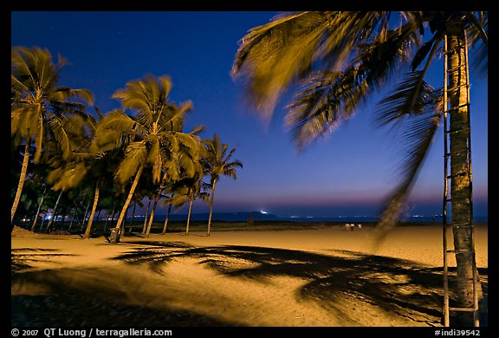
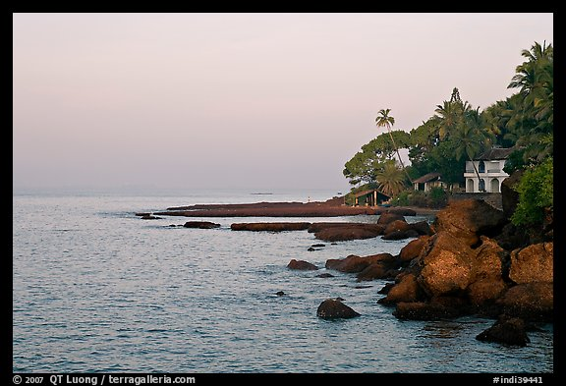
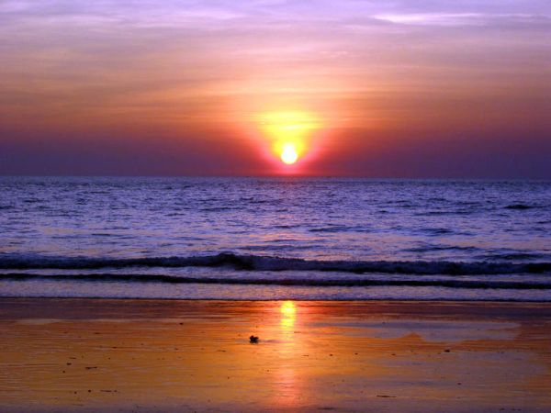

Slide 22
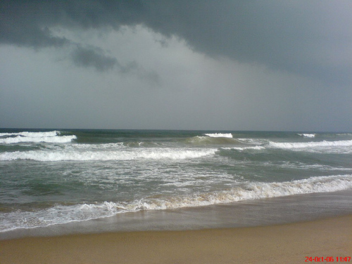
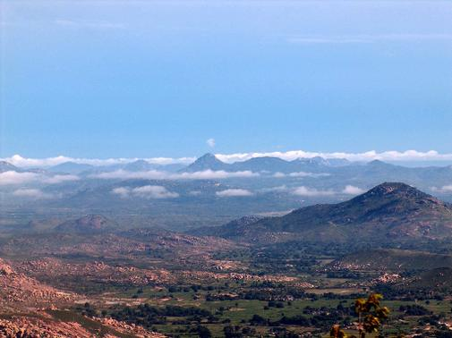
Eastern Coastal Plain

Slide 23
The Eastern Coastal Plain is a wide stretch of land lying between the Eastern Ghats and the Bay of Bengal. It stretches from Tamil Nadu in the south to West Bengal in the north. The Mahanadi, Godavari, Kaveri and Krishna rivers drain these plains and their deltas occupy most of the area. The temperature in the coastal regions exceeds 30 °C (86 °F) coupled with high levels of humidity. The region receives both the northeast and southwest monsoon rains. The southwest monsoon splits into two branches, the Bay of Bengal branch and the Arabian Sea branch. The Bay of Bengal branch moves northwards crossing northeast India in early June. The Arabian Sea branch moves northwards and discharges much of its rain on the windward side of Western Ghats. Annual rainfall in this region averages between 1,000 mm (40 in) and 3,000 mm (120 in). The width of the plains varies between 100 and 130 km (62 to 80 miles).The plains are divided into six regions — the Mahanadi delta, the southern Andhra Pradesh plain, the Krishna-Godavari deltas, the Kanyakumari coast, the Coromandel Coast and sandy coastal.

Slide 24
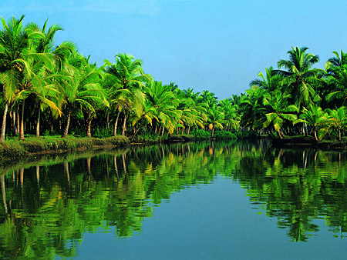
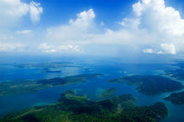
Western Coastal Plain

Slide 25
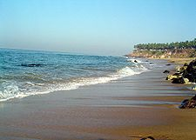
The Western Coastal Plain is a narrow strip of land sandwiched between the Western Ghats and the Arabian Sea, ranging from 50 to 100 km (30 to 60 miles) in width. It extends from Gujarat in the north and extends through Maharashtra, Goa, Karnataka and Kerala. Numerous rivers and backwaters inundate the region. Originating in the Western Ghats, the rivers are fast-flowing and mostly perennial, leading to the formation of estuaries. Major rivers flowing into the sea are the Tapi, Narmada, Mandovi and Zuari. The coast is divided into 3 parts namely, Konkan, which is situated in Maharashtra,Goa and northern parts of Karnataka; the Kanara in Karnataka and the Malabar Coast in Kerala. Vegetation is mostly deciduous, but the Malabar Coast moist forests constitute a unique ecoregion.

Slide 26
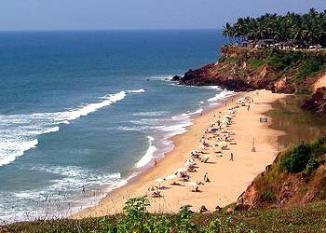
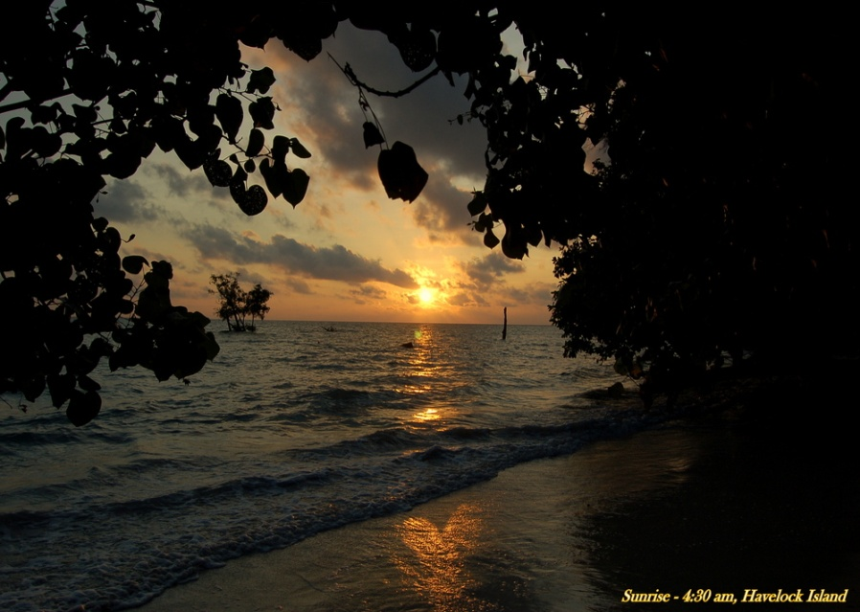
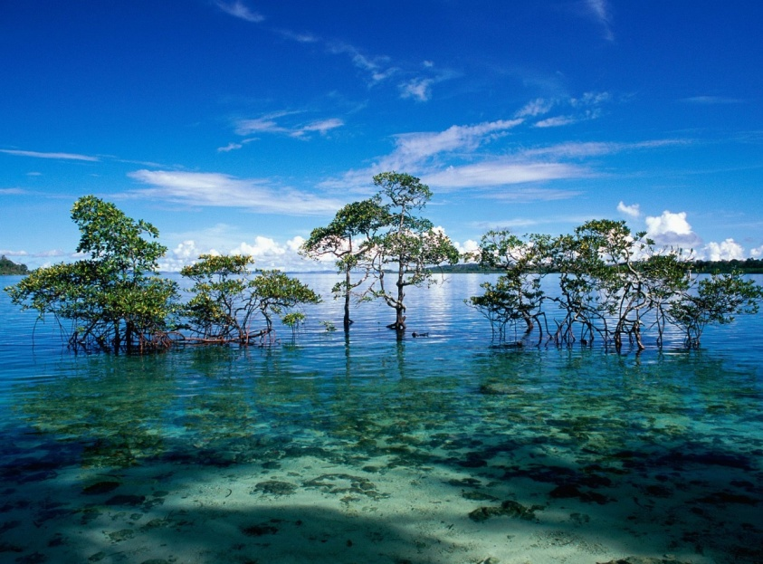
Islands

Slide 27
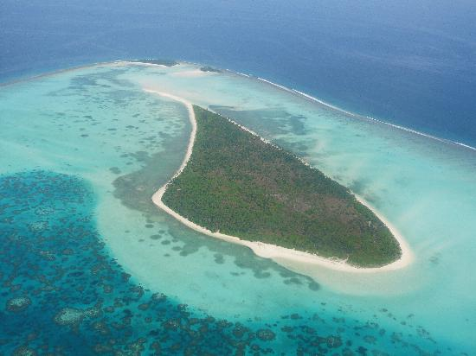
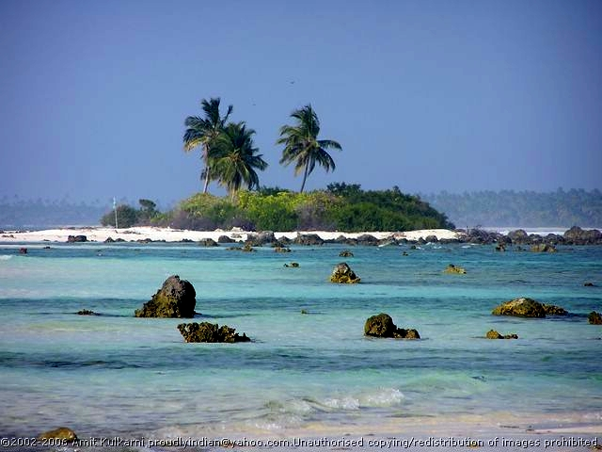
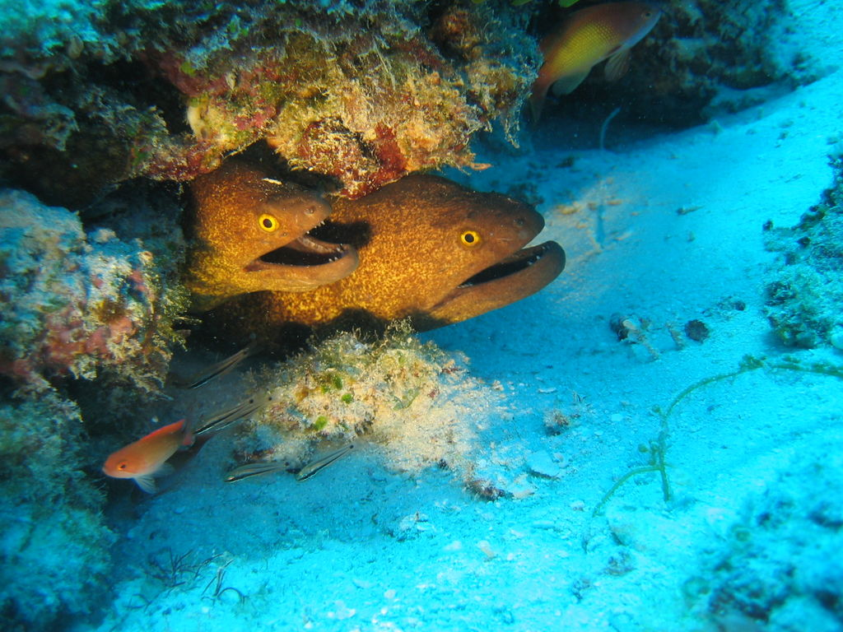
Lakshadweep

Slide 28
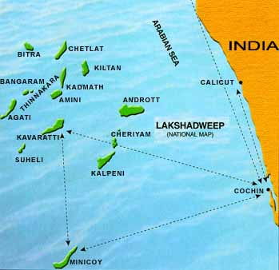
The Lakshadweep and the Andaman and Nicobar Islands are India's two major island formations which are classified as union territories. Lakshadweep also known as the Laccadive Islands, is a group of islands in the Laccadive Sea, 200 to 440 km off the coast of the South West Indian state of Kerala. The islands form the smallest Union Territory of India. The total land area is 11 sq mi or 32 km².Ten of the islands are inhabited. Lakshadweep is the northern part of the erstwhile Lakshadweepa. The islands are the northernmost among the Lakshadweep-Maldives-Chagos group of islands, which are actually the tops of a vast undersea mountain range, in the Indian Ocean and the Arabian Sea.
The land area is 32 km²; the lagoon area is about 4200 km², the territorial waters area is 20,000 km² and the economic zone area is 400,000 km².

Slide 29
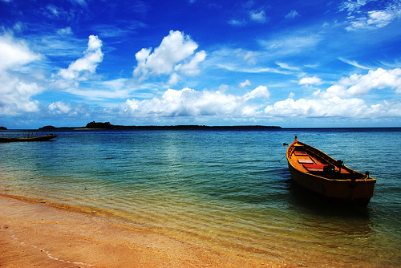
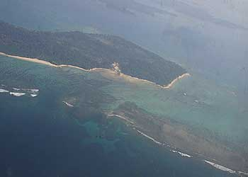
Andaman And Nicobar Islands

Slide 30
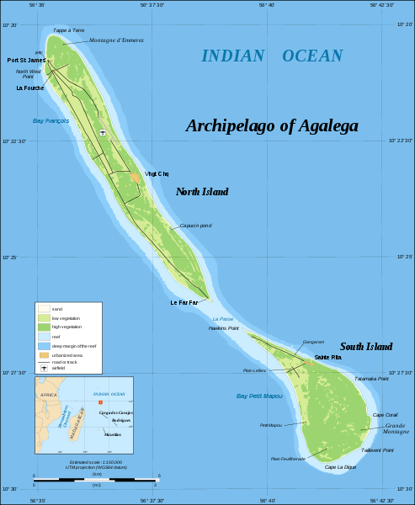
The Andaman and Nicobar Islands are located between 6º and 14º North latitude and 92º and 94º East longitude.They consist of 572 isles, lying in the Bay of Bengal near the Myanmar coast. It is located 1255 km (780 miles) from Kolkata (Calcutta) and 193 km (120 miles) from Cape Negrais in Myanmar. The territory consists of two island groups, the Andaman Islands and the Nicobar Islands. The Andaman Islands consists of 204 small islands with a total length of 352 km (220 miles). India's only active volcano, Barren Island is situated here, having last erupted in May 2005. The Narcondum is a dormant volcano and there is a mud volcano at Baratang. Indira Point, India's southernmost land point is situated in the Nicobar islands, and lies just 189 km (117 miles) from the Indonesian island of Sumatra to the southeast. The highest point is Mount Thullier at 642 m (2,140 ft).

