Slide 1
PHYSICAL FEATURES OF INDIA
Made by N.SRINIVASARAO

Slide 2
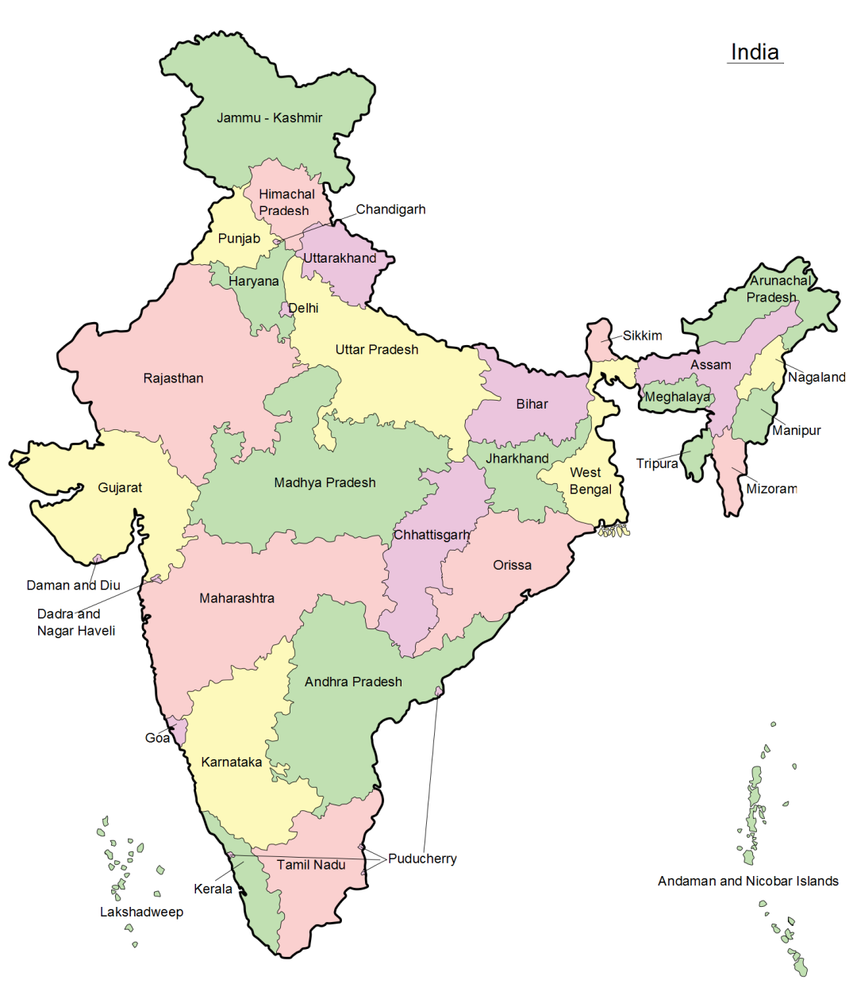
Introduction
India is a vast country with varied landforms. Our country has practically all major physical features of the Earth i. e. Mountains, Plains, Deserts, Plateaus and Islands. India is a large landmass formed during different geological periods which has influenced her relief its present form. The movement of the plates results in building up of stresses within the plates and the continental rocks above, leading to folding, faulting and volcanic activity.

Slide 3
CLASSIFICATION OF PLATE MOVEMENTS
Plate movements are classified into three types. They are; Convergent Boundary While some plates come towards each other and form convergent boundary. Divergent Boundary some plates move away from each other and form divergent boundary. Transform Boundary In the event of two plates coming together they may either collide and crumble, or one may slide under the other. At times, they may also move horizontally past each other and form transform boundary.

Slide 4
Plate Boundaries

Slide 5
PLATE BOUNDARIES
The oldest landmass, (the Peninsula part), was a part of the Gondwana land. The Gondwana land included India, Australia, South Africa and South America as one single land mass. The convectional currents split the crust into a number of pieces, thus leading to the drifting of the Indo-Australian plate after being separated from the Gondwana land, towards north. The northward drift resulted in the collision of the plate with the much larger Eurasian Plate. Due to this collision, the sedimentary rocks which were accumulated in the geosyncline known as the Tethys were folded to form the mountain system of western Asia and Himalaya.

Slide 6
PLATE BOUNDARIES (Cont…)
The Himalayan uplift out of the Tethys Sea and subsidence of the northern flank of the peninsular plateau resulted in the formation of a large basin. In due course of time this depression, gradually got filled with deposition of sediments by the rivers flowing from the mountains in the north and the peninsular plateau in the south. A flat land of extensive alluvial deposits led to the formation of the northern plains of India. The land of India displays great physical variation. Geologically, the Peninsular Plateau constitutes one of the ancient landmasses on the earth’s surface. The northern plains are formed of alluvial deposits. The Peninsulas Plateau is composed of igneous and metamorphic rocks with gently rising hills and wide valleys.

Slide 7
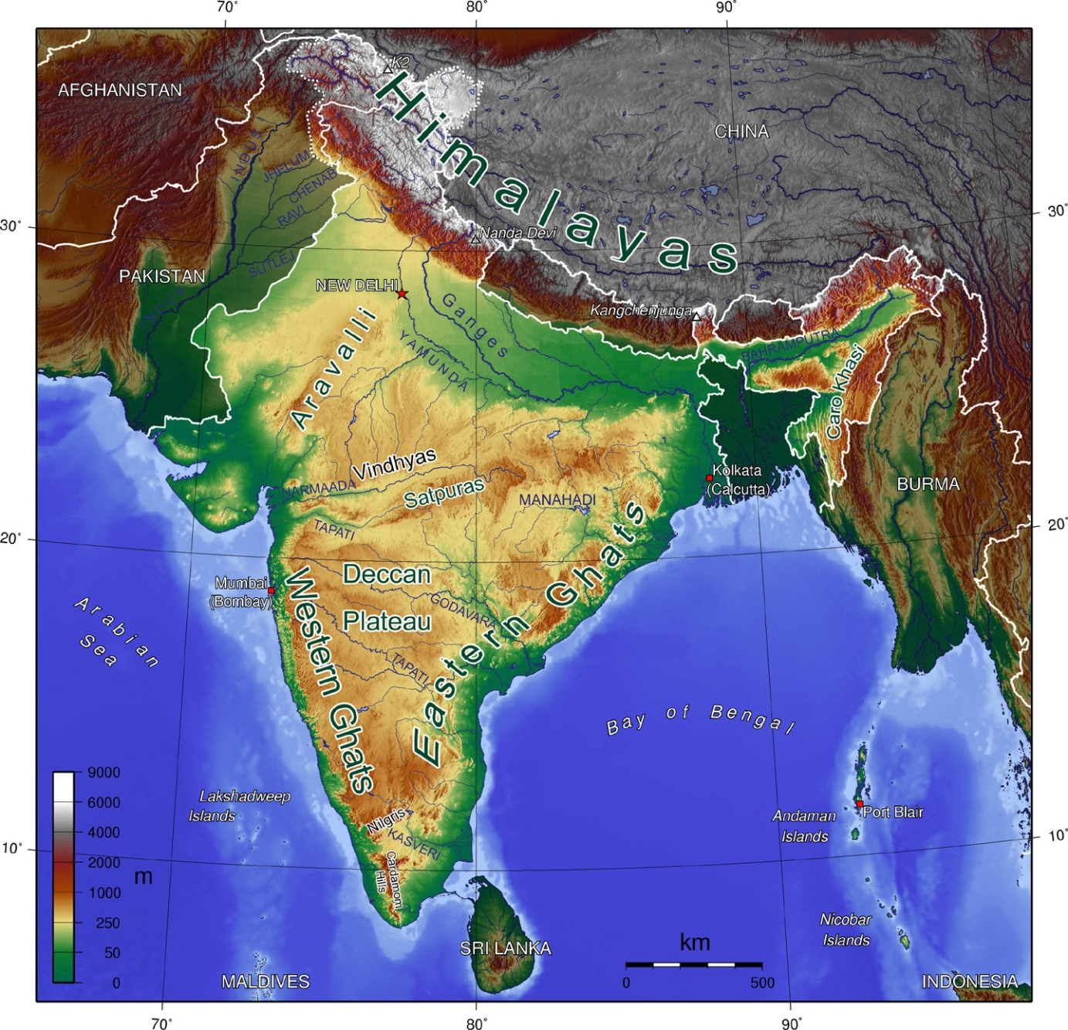
Major Physiographic Divisions

Slide 8
Major Physiographic Divisions
The Physical features of India can be grouped under the following physiographic divisions
The Himalayan Mountains.
The Northern Plains
The Peninsular Plateau
The Indian Desert
The Coastal Plains
The Islands

Slide 9
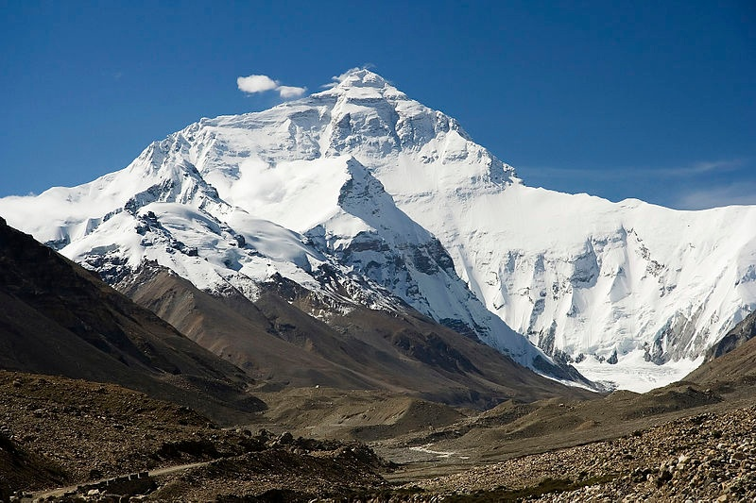
THE HIMALAYAN MOUNTAINS

Slide 10
THE HIMALAYAN MOUNTAINS
The Himalayan Mountains ranges contain several high peaks. Mount Everest is the highest peak in the world. The Himalayan Mountains stretch in a long curve from Jammu and Kashmir in the west to Arunanchal Pradesh in the east. Their length is about 2000 kilometres and width between 230 and 400 kilometers. The Himalayas act as a natural barrier to the North. These mountain ranges run in a west-east direction from the Indus to the Brahmaputra. The Himalaya consists of three parallel ranges in its longitudinal extent. A number of valleys lie between these ranges. The northern most range is known as the Greater or Inner Himalayas or the ‘Himadri’.

Slide 11
THE HIMALAYAN MOUNTAINS (Cont…)
The range lying to the south of the Himadri forms the most rugged mountain system and is known as Himachal or Lesser Himalaya. The ranges are mainly composed of highly compressed and altered rocks. The outermost range of the Himalayas is called the Shiwaliks. They extend over a width of 10-50 km and have an altitude varying between 900 and 1100 metres. These ranges are composed of unconsolidated sediments brought down by rivers from the main Himalayan ranges located farther north. The longitudinal valley lying between lesser Himalaya and the Shiwaliks are known as Duns. The Brahmaputra marks the eastern most boundary of the Himalayas.

Slide 12
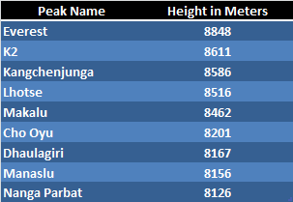
Some Highest Peaks of the Himalayas

Slide 13
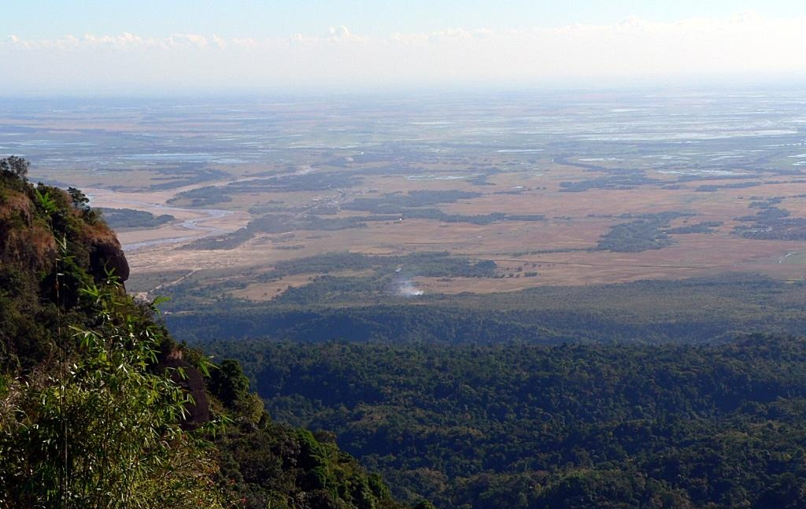
THE NORTHERN PLAINS

Slide 14
THE NORTHERN PLAINS
The Northern plain has been formed by the interplay of the three major river systems, namely- the Indus, the Ganga, the Brahmaputra along with their tributaries. This plain is formed of alluvial soil. The deposition of alluvium in a vast basin lying at the foothills of the Himalaya over millions of years, formed this fertile plain. It spreads over an area of 7 lakh sq. km. The plain being about 2400 km long and 240 to 320 km broad, is a densely populated physiographic division. The rivers in their lower course split into numerous channels due to the deposition of silt. These channels are known as distributaries.

Slide 15
THE NORTHERN PLAINS (cont…)
The Northern plain is broadly divided into three. The Western part of the Northern Plain is referred to as the Punjab Plains. Formed by the Indus and its tributaries, the larger part of this plain lies in Pakistan. The Ganga plain extends between Ghaggar and Teesta rivers. It is spread over the states of North India, Haryana, Delhi, U. P., Bihar, partly Jharkhand and West Bengal to its East, particularly in Assam lies the Brahmaputra plain.

Slide 16
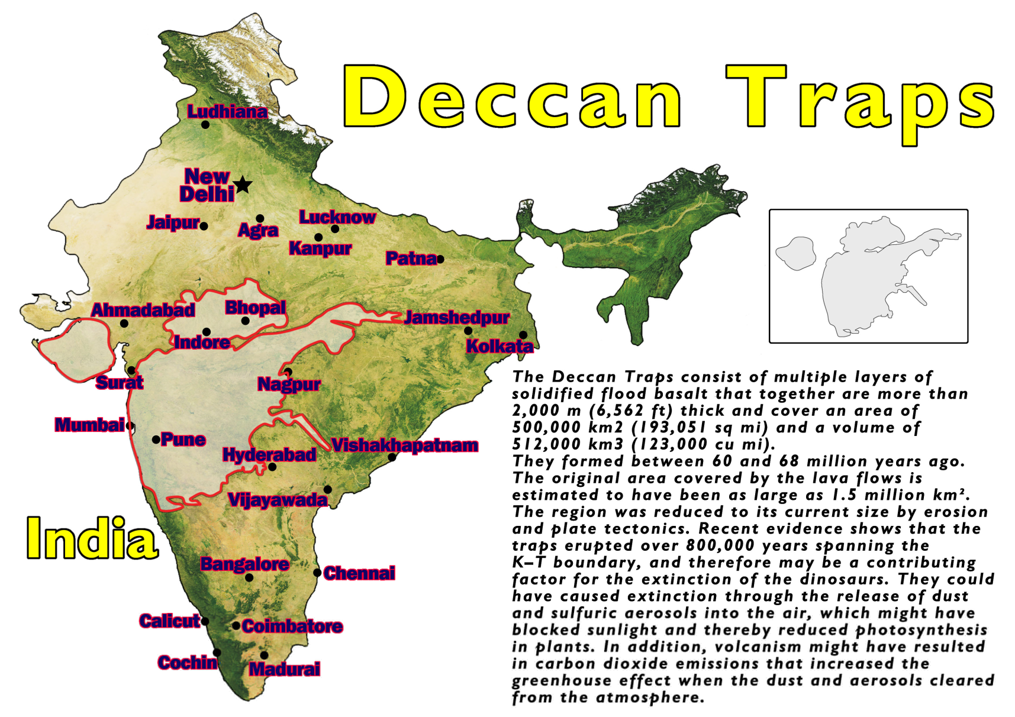
THE PENINSULAR PLATEAU

Slide 17
THE PENINSULAR PLATEAU
The Peninsular Plateau is a tableland composed of the old crystalline, igneous and metamorphic rocks. It was formed due to the breaking and drifting of the Gondwana land and thus, making it a part of the oldest landmass. The plateau has broad and shallow valleys and rounded hills. This plateau consists of two broad divisions, namely, the Central Highlands and the Deccan Plateau. The Vindhyan range is bounded by the Central Highlands on the south and the Aravalis on the northwest. The eastward extensions of this plateau are locally known as the Bundelkhand and Baghelkhand. The Deccan Plateau is a triangular landmass that lies to the south of the river Narmada.

Slide 18
THE PENINSULAR PLATEAU
The Western Ghats and the Eastern Ghats mark the western and eastern edges of the Deccan Plateau respectively. Western Ghats lie parallel to the western coast. They are continuous and can be crossed through passes only. The Western Ghats are higher than Eastern Ghats. The Eastern Ghats stretch from the Mahanadi Valley to the Nigiris in the south. They are discontinuous and irregular and dissected by rivers draining into the Bay of Bengal. One of the distinct features of the peninsular plateau is the black soil area known as Deccan Trap. This is of volcanic origin hence the rocks are igneous. The Aravali Hills lie on the western and north-western margins of the peninsular plateau.

Slide 19
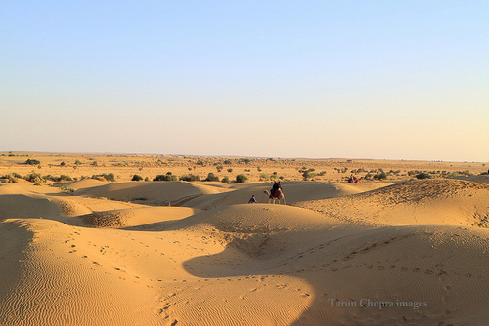
THE INDIAN DESERT

Slide 20
THE INDIAN DESERT
The Indian desert lies towards the western margins of the Aravali Hills. It is an undulating sandy plain covered with sand dunes. This region receives very low rainfall below 150 mm per year. It has arid climate with low vegetation cover. Streams appear during rainy season.

Slide 21
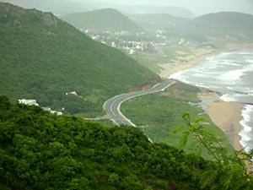
THE COASTAL PLAINS

Slide 22
THE COASTAL PLAINS
The Peninsular plateau is flanked by stretch of narrow coastal strips, running along the Arabian Sea on the west and the Bay of Bengal on the east. The western coast, sandwiched between the Western Ghats and the Arabian Sea, is a narrow plain. It consists of three sections. The northern part of the coast is called the Konkan(Mumbai-Goa), the central stretch is called the Kannad Plain while the southern stretch is referred to as the Malabar Coast. The plains along the Bay of Bengal are wide and level. In the northern part, it is referred to as the Northern Circar, while the southern part is known as the Coromandel Coast. Large Rivers such as the Mahanadi, the Godavari, the Krishna, and the Kaveri have formed extensive delta on this coast. Lake Chilika is an important feature along the eastern coast.

Slide 23
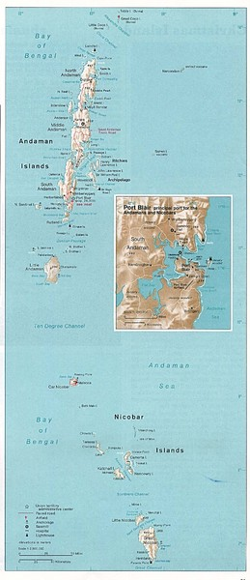
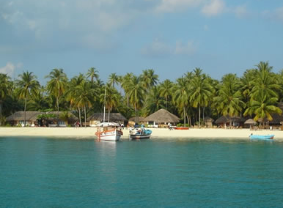
THE ISLANDS

Slide 24
THE ISLANDS
The Lakshadweep Islands group lying close to the Malabar coast of Kerala. This group of islands is composed of small coral islands. Earlier they were known as Laccadive, Minicoy and Amindive. In 1973 these were named as Lakshadweep. It covers small area of 32 sq. km. Kavaratti Island is the administrative head-quarters of Lakshadweep. This island group has great diversity of flora and fauna. The Pitti Island, which is uninhabited, has a bird sanctuary. The elongated chain of islands located in the Bay of Bengal extending from north to south.

Slide 25
THE ISLANDS
These are Andaman and Nicobar islands. They are bigger in size and are more numerous and scattered. The entire group of islands is divided in to two broad categories- The Andaman in the north and the Nicobar in the south. It is believed that these islands are an elevated portion of submarine mountains. These island groups are of great strategic importance for the country. There is great diversity of flora and fauna in this group of islands too. These islands lie close to equator and experience equatorial climate and thick forest cover.

Slide 26
Thankyou

