Slide 1
Physical features of India
Physical features of India

Slide 2
6 Physical features
The 6 physical features are :
The Himalayan mountains
The northern plains
The peninsular plateau
The Indian desert
The coastal plains
The Islands

Slide 3
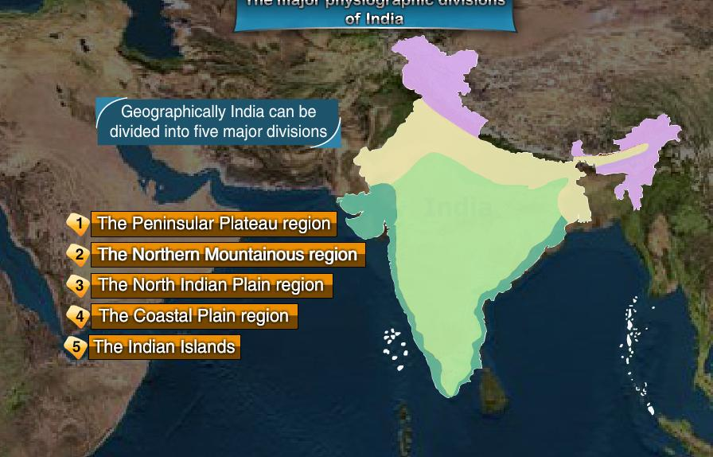
Indian Deserts

Slide 4
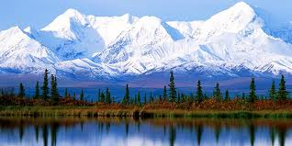
The Himalayas
The Himalayas are geologically young and structurally fold mountains which stretch over the northern borders of India .
These mountain ranges run in a west – east direction from Indus to Brahmaputra.
Himalayas covers a distance of about 2400km . Their width varies from 400km in Kashmir to 150km in Arunachal Pradesh .

Slide 5
Longitudinal division
The Himalaya consist of three parallel ranges in its longitudinal extent :
The northern most rangeis known as the inner Himalayas or the Himadri . It is most continuous range consisting of the loftiest peaks with an average height of 6000m . It consist of all prominent Himalayan peaks .
The range lying to the south of Himadry forms the most rugged mountain system and is also known as Himachal or lesser Himalaya . The altitude varies between 3700 and 4500m and the average width is of 50 km . This range is famous for hill station like Kangra and Kullu valley .
The outer most range of the Himalayas is called the Shiwaliks . They extend over a width of 10-50km and have an altitude varying between 900 – 1100m . This range is famous for duns like dehra dun kotli dun etc .

Slide 6
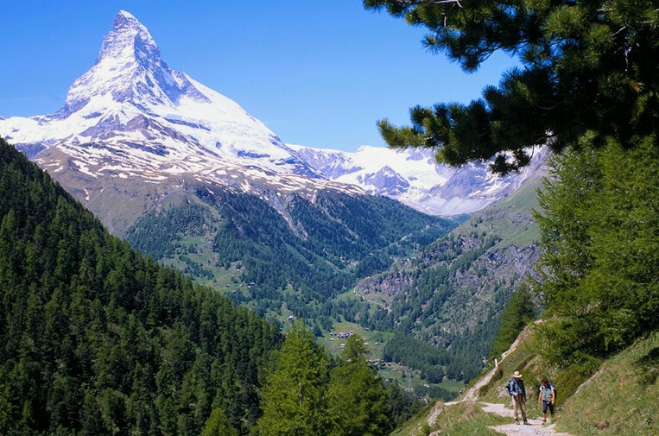
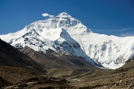
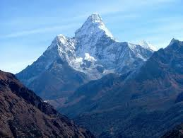

Slide 7
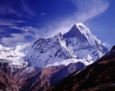
West to east division
The Himalaya has been divided on the basis of regions from west to east . The part of Himalaya lying between Indus and satluj has been traditionally known as Punjab Himalayas . The part of Himalayas lying between satluj and kali rivers is known as kumoun Himalayas . The kali and the tista rivers demarcate the Nepal Himalayas . And the Himalayas lying between tista and dihang rivers is known as Assam Himalayas . The Himalayas which spread along the eastern boarders of India is known as purvachal .

Slide 8
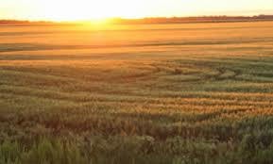
Northern plains
The northern plain has been formed by the interplay of three major river systems ; the Indus , the Brahmaputra ,the Ganga along with their tributaries . This plain is formed of alluvial soil . The deposition of alluvium in a vast basin lying at the foothills of the Himalaya over millions of years , formed this fertile plain . It spreads over an area of 7 lakh sq.km . The plain being about 2400km long and 240 to320 km broad , is a densely populated physiographic division . With a rich soil cover combined with adequate water supply and favorable climate it is agriculturally a very productive part of India .

Slide 9
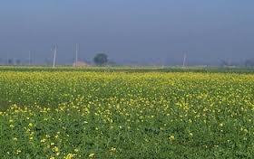
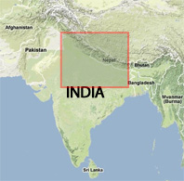
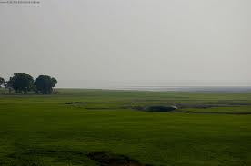

Slide 10
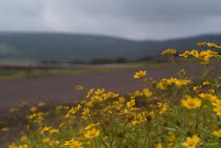
The peninsular plateau
The peninsular plateau is a table land composed of the old crystalline , igneous and metamorphic rocks . It was formed due to the breaking and drifting of gondwana land and thus making it a part of the oldest landmass . This plateau consist of 2 broad divisions :the Central highlands and the Deccan plateau .

Slide 11
Central Highlands And Deccan Plateau
The part of the peninsular plateau lying to the north of Narmada river covering a major area of Malwa plateau is known as Central highlands .
The Deccan plateau is a triangular landmass lying to the south of river Narmada . The Satpura range flanks its broad base in the north while the Mahadev , the Kaimul hills and the Maikal range form its eastern extension .

Slide 12
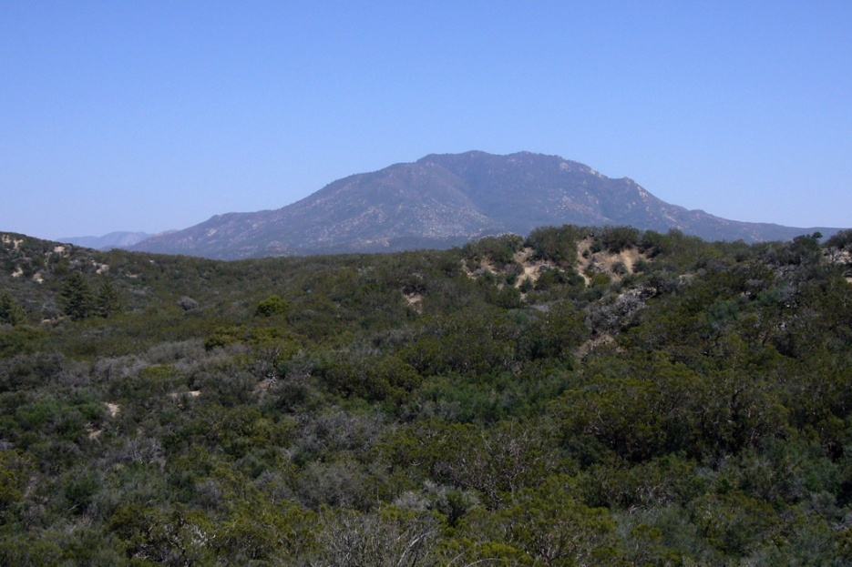
Western Ghats
Western Ghats lie parallel to the western coast . They are continues and can be crossed through passes only . The western Ghats are higher than the eastern Ghats . Their average elevation is 900 to 1600 m . The western Ghats cause orographic rain by facing the rain bearing moist winds to rise along the western slopes of then Ghats . The western Ghats are known by different local names . The highest peaks include anai mudi and the doda betta

Slide 13
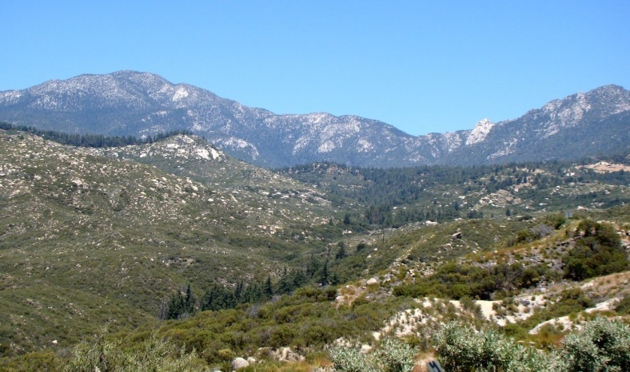
Eastern Ghats
Eastern Ghats are lower than Western Ghats. The average elevation of Eastern Ghats is 600 mts. The Eastern Ghats stretch from the Mahanadi Valley to the Nigiris in the south. The Eastern Ghats are discontinuous and irregular and dissected by river draining into the Bay of Bengal. Mahindragiri is the highest peak in the Eastern Ghats. Shevroi Hills and the Javadi Hills are located to the south-east of Eastern Ghats.

Slide 14
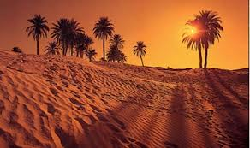
The Indian deserts
The Indian Deserts lies towards the western margins of the Aravali hills . It is an undulating sandy plain covered with sandunes this region resives very low rainfall below 150 mm per year . It has arid climate with low vegetation cover . Streams apear during the rainy season . Soon after they disappear into the sand as they do not have enough water to reach the sea . Luni is the only large river in this region . Barchans cover larger areas but longitudinal dunes become more prominent near the indo – Pakistan boundary .

Slide 15
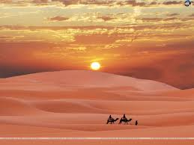
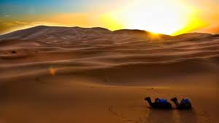
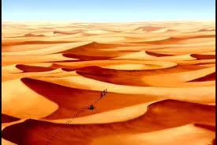
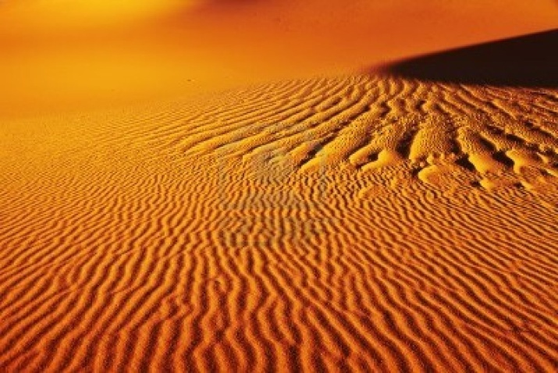

Slide 16
The coastal plains
The peninsular plateau is flanked by stretch of narrow coastal strips , running along the Arabian sea on the west and the bay of Bengal on the east . The western coast , sandwiched between the western Ghats and the Arabian sea is a narrow plain . It consist of three sections . The northern part of the coast is called the konkan , the central stretch is called the kannad plain while southern is referred to as the Malabar coast the plains along the bay of Bengal are wide and level in the northern part , it is referred to as the northern circar , while the southern part is known as koramandal coast . Large rivers such as the Mahanadi , the Godavari , the Krishna and the kavery have former extensive delta on this coast . Lake chilika is an important feature along the eastern coast

Slide 17
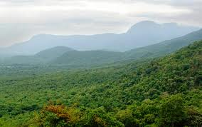
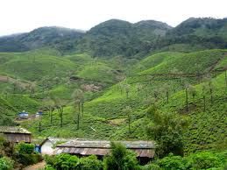

Slide 18
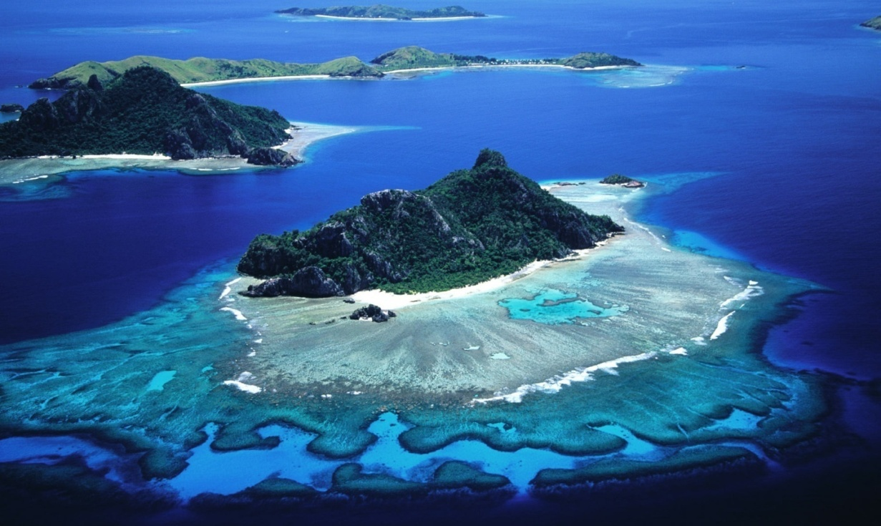
The islands
Besides a vast main land , India has also 2 groups of islands . The Lakshadweep islands close to the Malabar coast of Kerala is composed of small coral islands . It covers small area of 32 sq . Km and kavarathi island is the administrative head quarters . This island group has great diversity of flora and fauna the pity island , which is uninhabited, has a bird sanctuary .

Slide 19
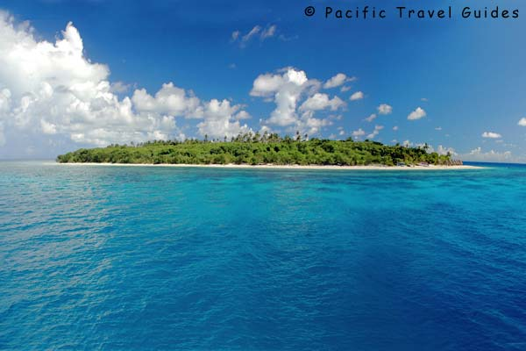
Andaman and Nicobar
The Andaman and nicobar islands is located in the bay of Bengal they are bigger in size and are more numerous and scattered . The entire group of islands is divided into 2 broad categories the Andaman in the north and the nicobar in the south . These islands lie close to equator and experience equatorial climate and has thick forest cover .

Slide 20
Made by :
N.SRINIVASARAO

