Slide 1
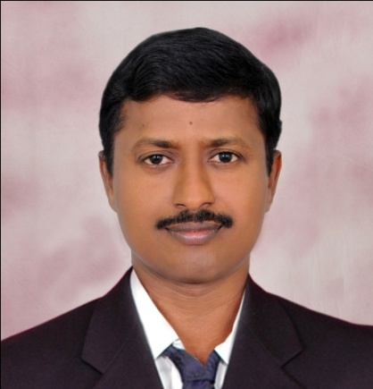
(AS ON 11-11-2014)
LATEST WHO IS WHO
India
By:
K. Suresh, S.A., S.S., Z.P. (Boys) High School, SRIKALAHASTI
GURUDEVA.COM - NEW

Slide 2
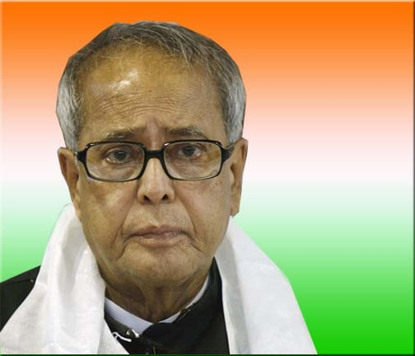
ప్రస్తుత భారత రాష్ట్రపతి శ్రీ ప్రణబ్ ముఖర్జీ President of India Shri Pranab Mukherjee

Slide 3
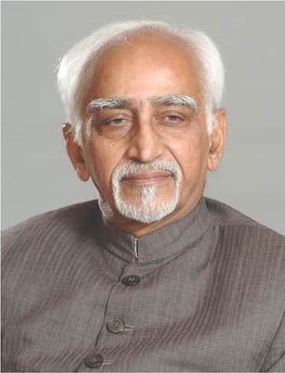
ప్రస్తుత భారత ఉపరాష్ట్రపతి శ్రీ హమీద్ అన్సారీ Vice President of India Shri Mohd. Hamid Ansari

Slide 4
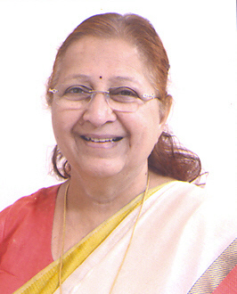
Sumitra Mahajan Speaker of the Lok Sabha

Slide 5
Narendra Modi Prime Minister, Personnel, Public Grievances and Pensions, Department of Atomic Energy Dept. of Space, All important policy issues and all other portfolios not allocated to any Minister

Slide 6
Rajnath Singh Home Affairs

Slide 7
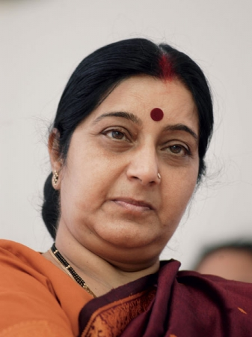
Sushma Swaraj External Affairs, Overseas Indian Affairs

Slide 8
Arun Jaitley Finance, Corporate Affairs, Defence

Slide 9
M Venkaiah Naidu Urban Development, Housing and Urban Poverty Alleviation, Parliamentary Affairs

Slide 10
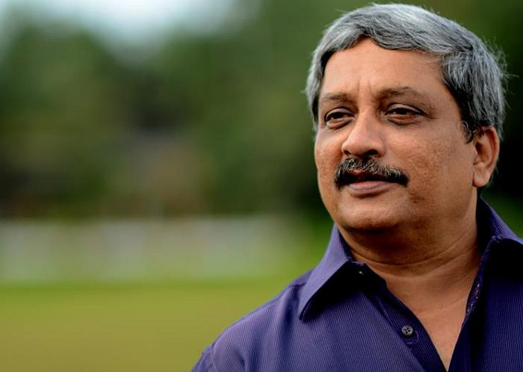
Manohar Parrikar:
Defence

Slide 11
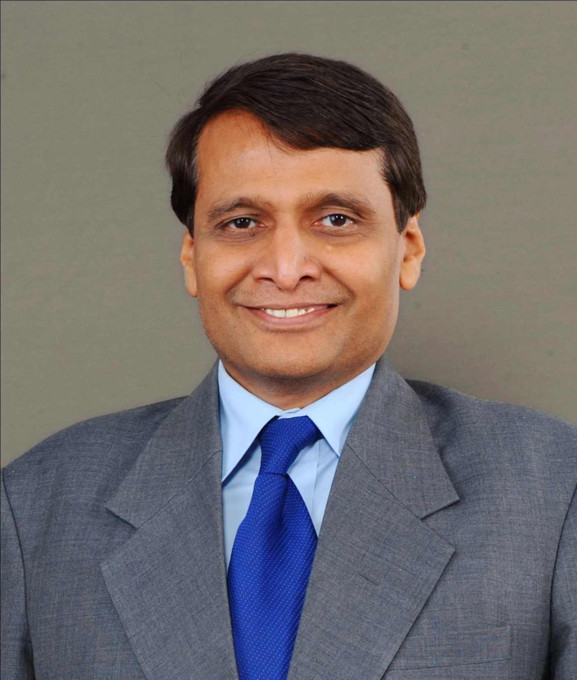
Suresh Prabhu:
Railways

Slide 12
Nitin Gadkari Road Transport and Highways, Shipping

Slide 13
D V Sadananda Gowda Railways

Slide 14
Uma Bharti Water Resources, River Development and Ganga Rejuvenation

Slide 15
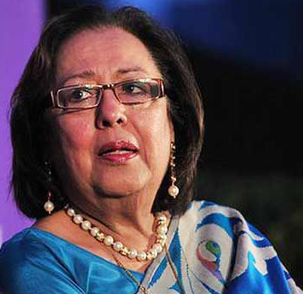
Najma Heptullah Minority Affairs

Slide 16
Ramvilas Paswan Consumer Affairs, Food and Public Distribution

Slide 17
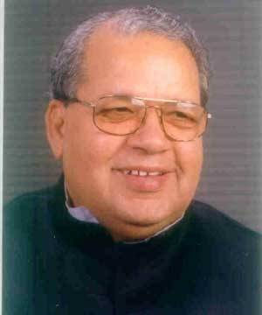
Kalraj Mishra Micro, Small and Medium Enterprises

Slide 18
Maneka Gandhi Women and Child Development

Slide 19
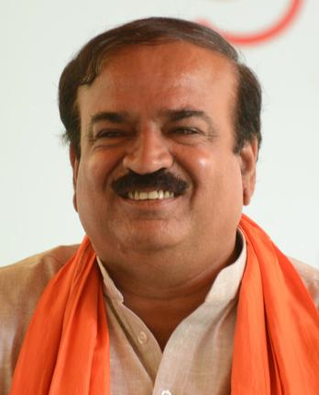
Ananth Kumar Chemicals and Fertilizers

Slide 20
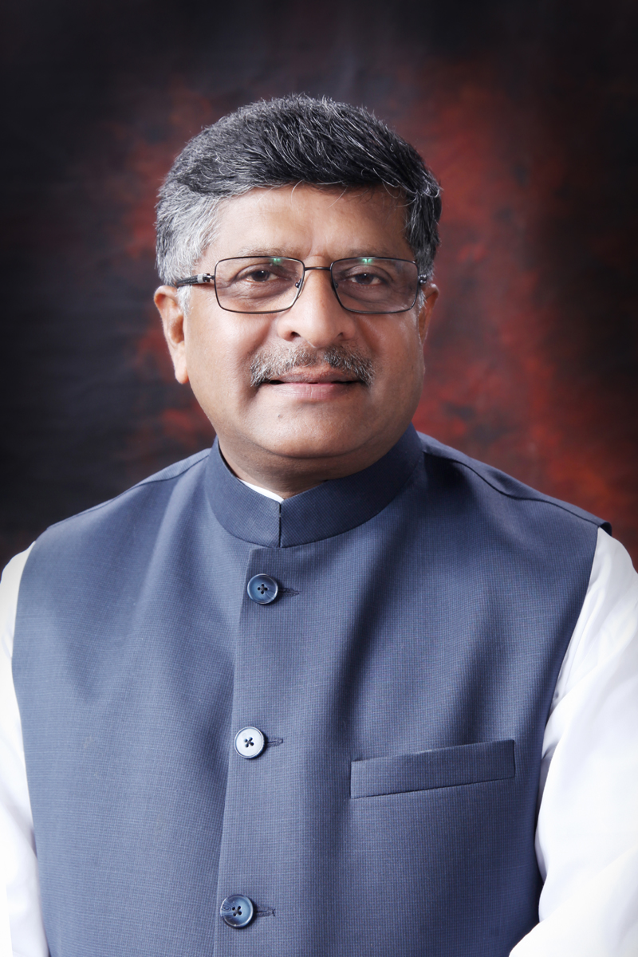
Ravi Shankar Prasad Communications and Information Technology, Law and Justice

Slide 21
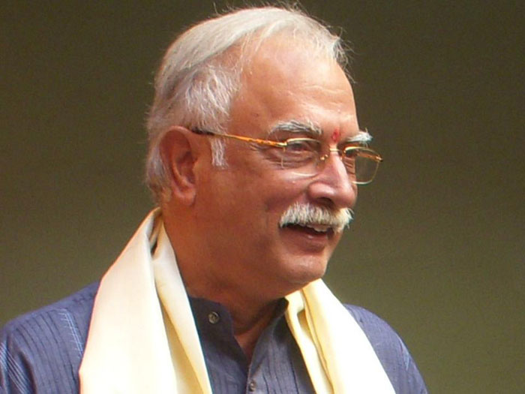
Pusapati Ashok Gajapathi Raju Civil Aviation

Slide 22
Anant Geete Heavy Industries and Public Enterprises

Slide 23
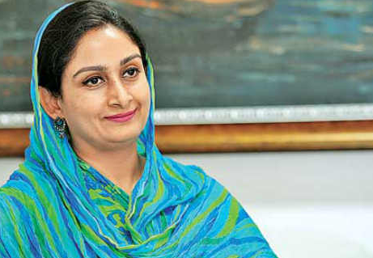
Harsimrat Kaur Badal Food Processing Industries

Slide 24
Narendra Singh Tomar Mines, Steel, Labour and Employment

Slide 25
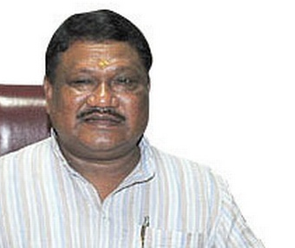
Jual Oram Tribal Affairs

Slide 26
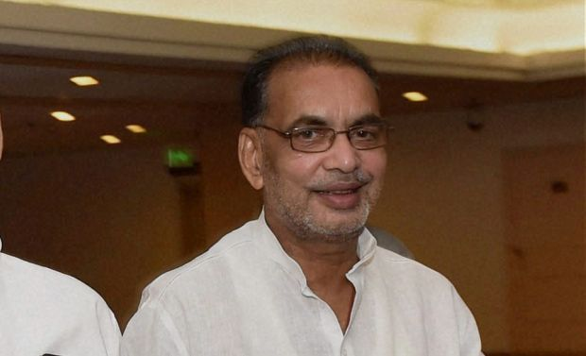
Radha Mohan Singh Agriculture

Slide 27
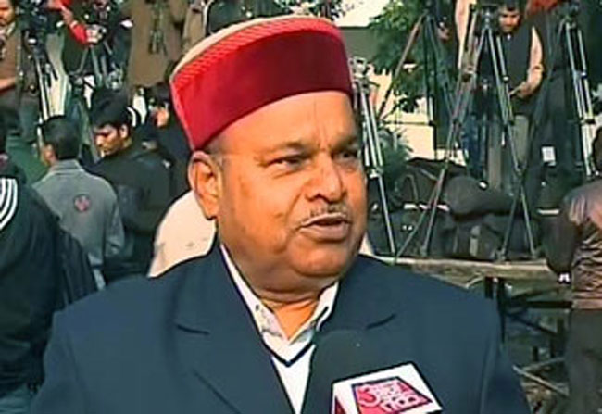
Thaawar Chand Gehlot Social Justice and Empowerment

Slide 28
Smriti Zubin Irani Human Resource Development

Slide 29
Dr Harsh Vardhan Health and Family Welfare

Slide 30
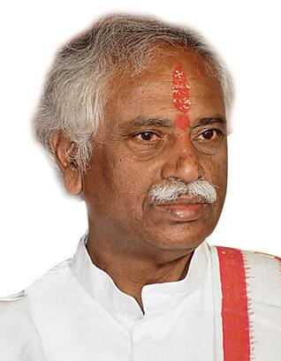
Bandaru Dattatreya:
Labour and Employment (Independent Charge)

Slide 31
Y.S. Chowdary:
Science and Technology, Earth Science

Slide 32
Col. Rajyavardhan Singh Rathore:
Information & Broadcasting

Slide 33
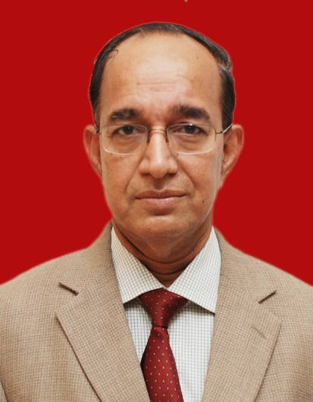
ప్రస్తుత భారత ఎన్నికల ప్రధాన అధికారి Chief election commissioner of India Veeravalli Sundaram Sampath (10 June 2012 to 16 January 2015)

Slide 34
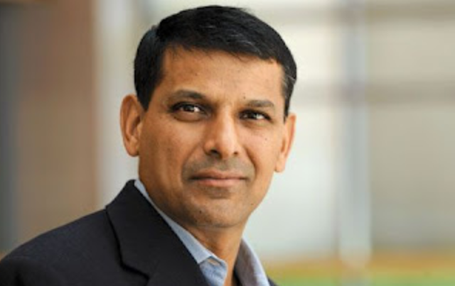
ప్రస్తుత భారత రిజర్వ్ బ్యాంక్ గవర్నర్ - శ్రీ రఘురాం రాజన్ 23rd Governor of the Reserve Bank of India Raghuram Rajan from 04-09-2013
GURUDEVA.COM - NEW

Slide 35
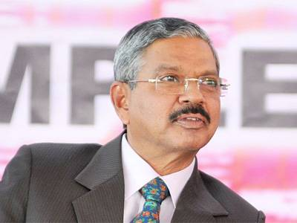
ప్రస్తుత భారత సుప్రీం కోర్టు ప్రధాన న్యాయమూర్తి జస్టిస్ H.L. దత్తు (42వ) CHIEF JUSTICE OF INDIA Justice H. L. DATTU 42nd Chief Justice of India from 28 September 2014

Slide 36
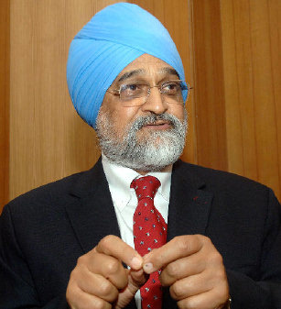
ప్రస్తుత భారత ప్రణాళికా సంఘం ఉపాధ్యక్షుడు శ్రీ మాంటెక్ సింగ్ అహ్లూవాలియా 24th Deputy Chairman of the Planning Commission: Montec Singh Ahluvalia from: 6 July 2004

Slide 37
ప్రస్తుత భారత జాతీయ మానవ హక్కుల ఛైర్మన్ శ్రీ K.G. బాలకృష్ణన్ National Human Rights Commission of India K.G. Balakrishnan

Slide 38
Thank you
K. Suresh, S.A., S.S., Z.P. (Boys) High School, SRIKALAHASTI

Slide 39
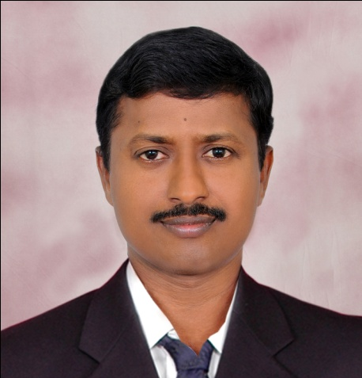
FOR MORE SOCIAL STUDIES PPTs, Videos, Previous Question Papers, Model papers, Lesson Plans, Teaching Notes, Materials, Maps……etc., in Telugu and English Mediums of APSCERT syllabus. Visit
http://sureshsrikalahasti.weebly.com/ gurudeva.com - new http://mana social.weebly.com
https://www.youtube.com/user/1973shekar
https://www.youtube.com/user/kunaatisuresh
K. SURESH

